Slide 1
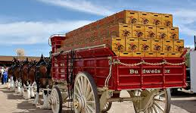
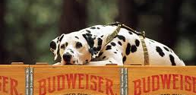
Competitive Intelligence Presented by: Jasmine Coleman
Budweiser

Slide 2


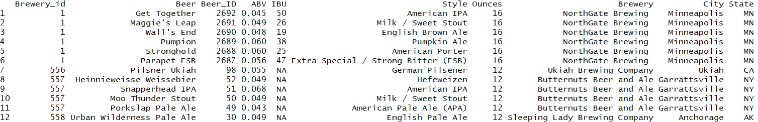
Data Overview
Beer Information
Brewery Information
2410 US Craft Beers
ABV: Alcohol by Volume
IBU: International Bitterness Units
Style
Ounces
Original brewery
Missing Values
558 US Breweries
City
State
Notes:
We are looking at a combo of beer and brewery info to get a better understanding of the competitive landscape and what markets we should target

Slide 3
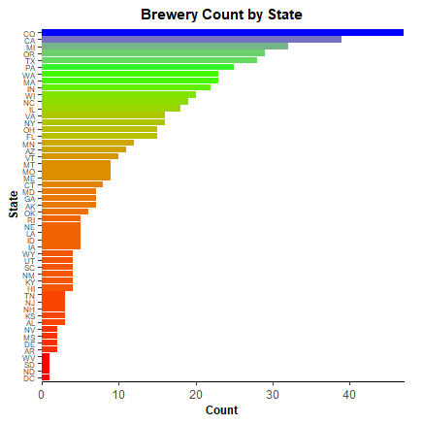
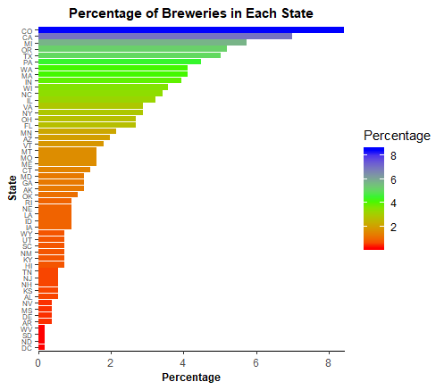
US Brewery Locations
Notes:
To start, we wanted to get an idea of how many breweries were in each state. At quick glance we can see that that number ranges from 47 in states like Colorado all the way down to several states only having 1 brewery including the District of Columbia.

Slide 4
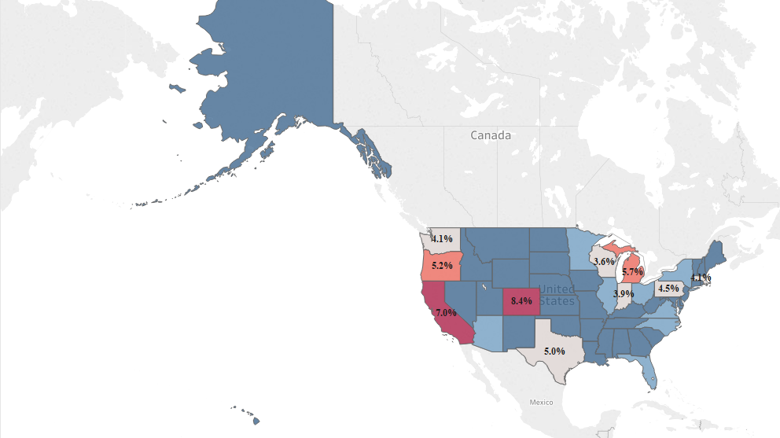
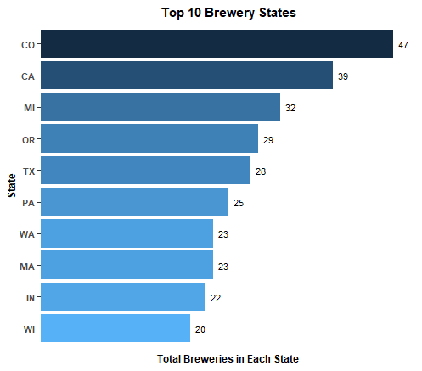
US Brewery Locations
51.6% of US Breweries are located in 10 States
Notes:
To get a better understanding of which markets we should focus on we looked at the top 10 states (housing) with the most breweries. Interestingly enough, we found that10 states housed over 50% of all US breweries.

Slide 5
